Slide 1
Hands on OFDM crash course
(Orthogonal Frequency-division Multiplexing:
standard modulation format for 5G New Radio)

Slide 2
You are here
2D vectors
Dot product formula
Orthogonal examples
Dot product vs. angle
Vector as a list of numbers
2D example
3D example
Dot product of vectors
Dot product of signals
Sum of periodical signals
Dot product of sinusoids
Sinewaves orthogonality
Orthogonal sinewaves amplitude modulation
Discrete Fourier Transformation
Vector as a signal - signal as a vector
Dot product of signals
Signal's similarity
Dot versus phase shift
Dot versus amplitudes
Interferences

Slide 3
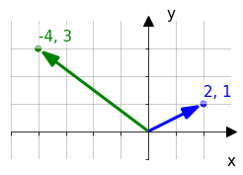
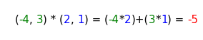
Dot product formula
Vector coordinates: b(blue) = (x, y); g(green) = (x, y)
Product formula: b*g = (x*x) + (y*y);
input: vectors,
output: scalar <- sum of multiplication of corresponding coordinates
g = (-4,3), b = (2, 1)
teacher\app_dot_2d_draw_and_calc.py

Slide 4
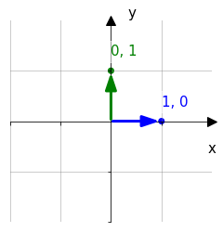
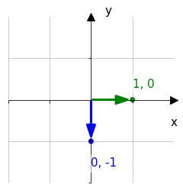
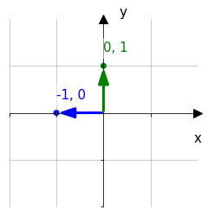
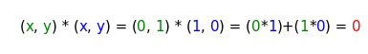
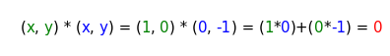
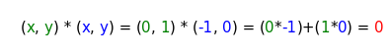
Dot Product: Orthogonal vectors examples
In all cases dot product equals to zero.
Maybe because one of the corresponding coordinates is always zero ?
0, 1
1, 0
1, 0
0,-1
0, 1
-1, 0
0, 0
0, 0
0, 0
teacher\app_dot_2d_draw_and_calc.py

Slide 5
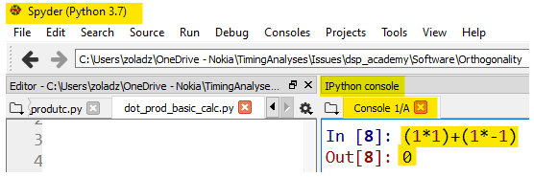
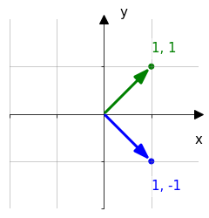
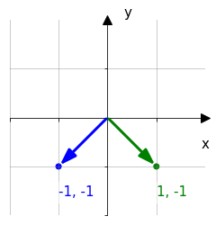
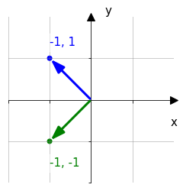
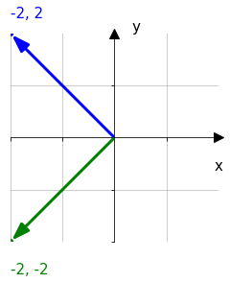
Dot Product: Orthogonal vectors examples: Nonzero coordinates
Calculate dot product of following vectors.
Use Spider REPL
REPL (stands from Read–Eval–Print Loop), A simple interactive computer programming environment
that takes single user inputs, executes them,
and returns the result to the user. [Wikipedia]
Calculations | (1*1)+(1*-1) | 1*(-1)+(-1)*(-1) | -1*(-1)+1*(-1) | -2*(-2)+(-2)*2
result | 0 | 0 | 0 | 0
Still zero ? Maybe because we use the coordinates of the same absolute value (1 or 2)?
teacher\app_dot_2d_draw_and_calc.py

Slide 6
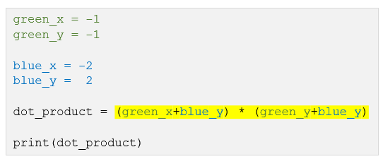
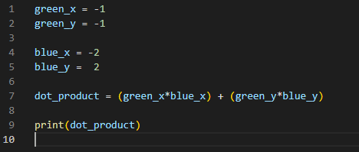
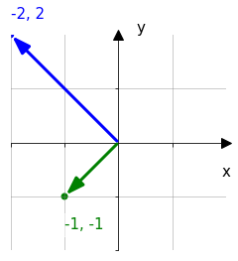
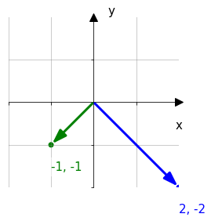
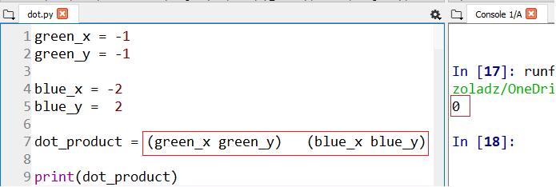
Dot Product: Orthogonal vectors examples: Nonzero coordinates, cont.
Calculate dot product of following vectors.
To work more efficiently instead of REPL use script on the right
Note: correct mistakes in dot product formula
Fix dot product formula
Run the script (F5)
Find result in console
0 | 0
Still zero ? Maybe because we use the same absolute value of a single vector coordinates (1 or 2)?
Notes:
1_SinewavesOrthogonality\1_DotProductOfVectors\1_dot_calc_manual_crds_separate.py

Slide 7
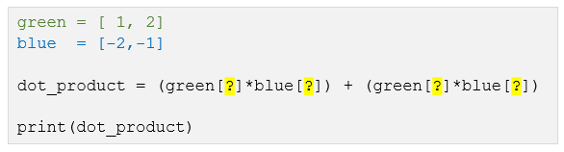
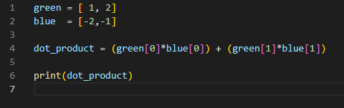
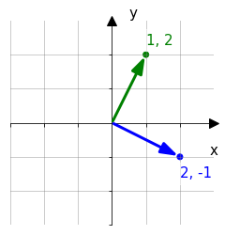
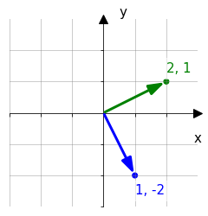
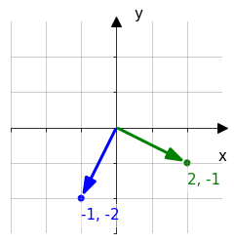
Dot Product: Orthogonal vectors examples: Nonzero coordinates, cont.
Calculate dot product of following vectors.
Use script with, more concise, vector coordinates notation (->).
(Use the same file)
0 | 0 | 0
Still zero ? Maybe because we use integer coordinates?
Notes:
11_SinewavesOrthogonality\1_DotProductOfVectors\2_dot_calc_crds_as_lists.py

Slide 8
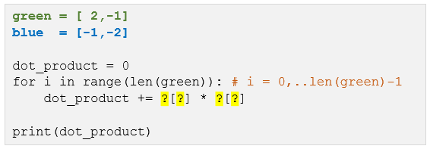
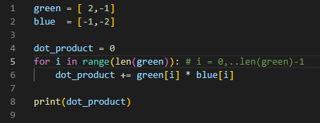
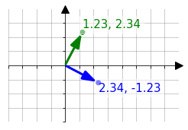
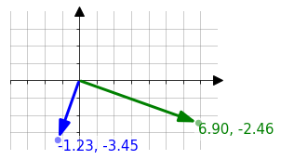
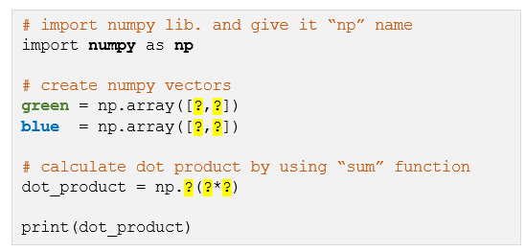
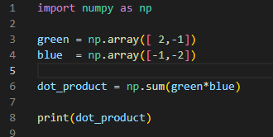
Dot Product: Orthogonal vectors examples: Nonzero coordinates, cont.
1. Calculate dot product of following vector configurations.
Use script version with “for” loop for iteration through vector indices. In this case these are 0 and 1.
This code works for vectors of any length.
1_SinewavesOrthogonality\1_DotProductOfVectors\3_dot_calc_loop_usage.py
2. Avoid loop-ing by using “sum” function from “numpy” library.
0 | 0
1_SinewavesOrthogonality\1_DotProductOfVectors\3_dot_calc_sum_usage.py
Evidently dot product of any perpendicular vectors equals to zero. How about other angles ?

Slide 9
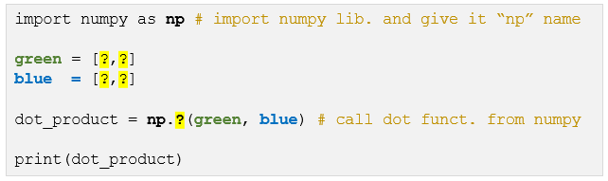
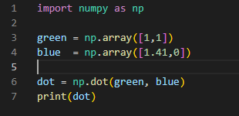
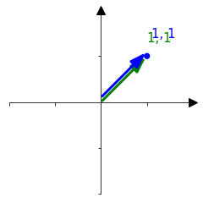
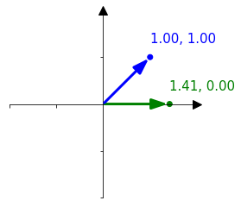
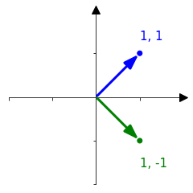
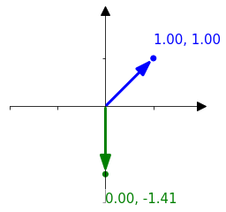
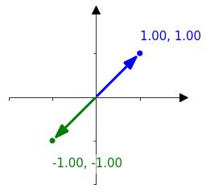
Dot Product: Non orthogonal vectors examples
Calculate dot product for the selected angles between vectors.
Take advantage of “dot” function from “numpy” library
dot product | 2 | 1.41 | 0 | -1.41 | -2
For which angle dot product has maximum value and for which a minimum value?
Dot product has maximum value for angles 2kπ and the minimal value for angles (2+1)kπ (in radians), where k is an integer
Notes:
1_SinewavesOrthogonality\1_DotProductOfVectors\4_dot_calc_np_function.py

Slide 10
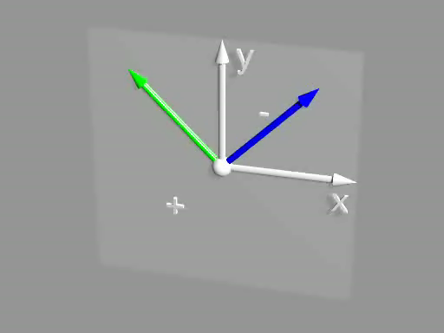
Dot Product: Non orthogonal vectors examples, cont.
Results from previous slide let us suppose that the dot product :
takes its maximum when the vectors points at same direction,
equals to zero when the vectors are orthogonal
takes its minimum when the vectors points at the opposite direction.
Click to play
2d_vect_dot.pov

Slide 11
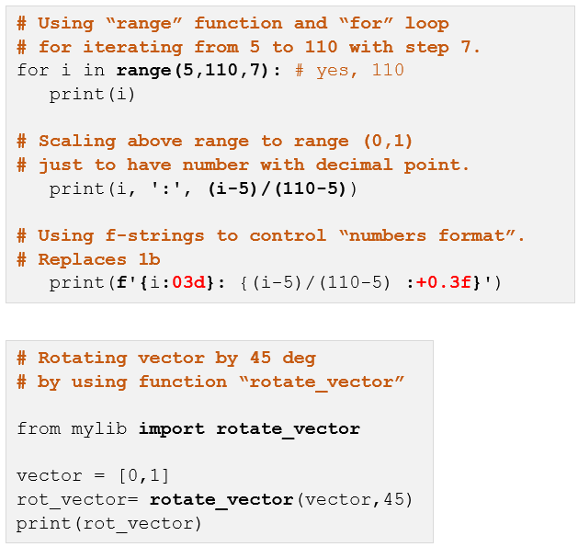
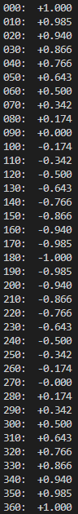
Dot Product v.s. vectors angle
Print dot product between green and blue vector for ${360}^{°}$ angle range with ${10}^{°}$ steps.
Assume that green vector is fixed at [0,1] and blue vector rotates.
Auxiliary examples (not solution for task)
Expected result
000: +1.000
010: +0.985
020: +0.940
...
360: +1.000
Notes:
1_SinewavesOrthogonality\1_DotProductOfVectors\5_dot_calc_angle_range_print.py

Slide 12
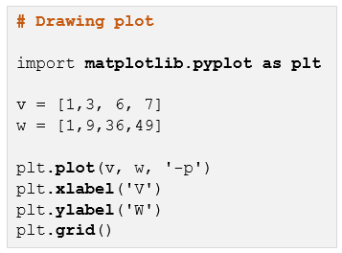
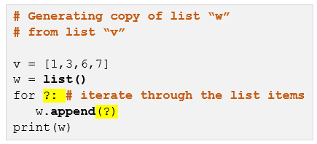
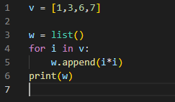
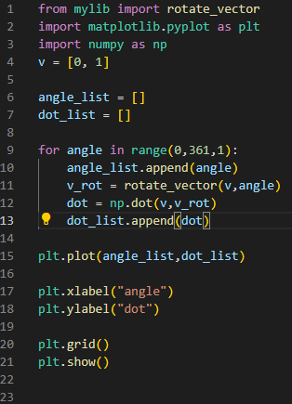
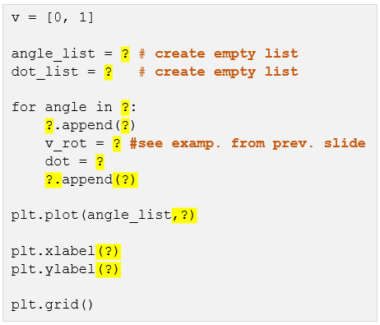
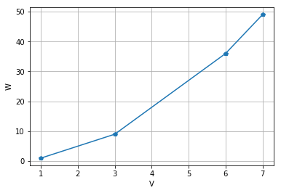
Dot Product v.s. vectors angle, cont.
“Replace” printing from previous slide with plotting.
dot
Auxiliary examples (not solution for task)
angle
6_plot_example.py
7_list_example.py
8_dot_calc_angle_range_plot.py
Notes:
1_SinewavesOrthogonality\1_DotProductOfVectors\:
- 6_plot_example.py
- 7_list_example.py
- 8_dot_calc_angle_range_plot.py

Slide 13
You are here
2D vectors
Dot product formula
Orthogonal examples
Dot product vs. angle
Vector as a list of numbers
2D example
3D example
Dot product of vectors
Dot product of signals
Sum of periodical signals
Dot product of sinusoids
Sinewaves orthogonality
Orthogonal sinewaves amplitude modulation
Discrete Fourier Transformation
Vector as a signal - signal as a vector
Dot product of signals
Signal's similarity
Dot versus phase shift
Dot versus amplitudes
Interferences

Slide 14
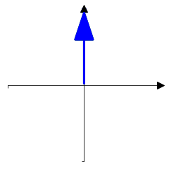
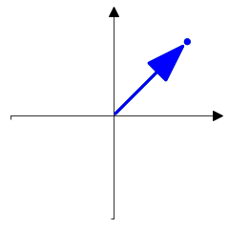
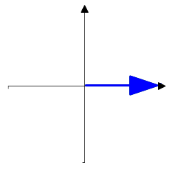
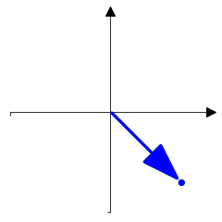
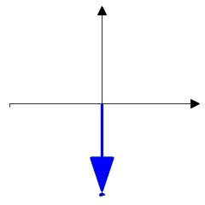











Vector as a list of numbers: 2D example
2D vector can be presented on a single axis as a list of values
y
teacher\vector_saples_view_2d.py
1
1
x
1
0.707
0
- 0.707
- 1

Slide 15

Vector as a list of numbers: 2D example, cont.
Find vectors orthogonal to vector A
cheat sheet
vector A | Orthogonal | Orthogonal | Antiparallel
4 | 1 | 7 | 6
8 | 3 | 5 | 2
Replace question marks with vector index.
Use REPL or script
teacher\aux_dot_calc_angle_range_plot.py
1
2
3
4
5
6
7
8
0.707, -0.707
1, 0
0, 1
0.707, 0.707
0, -1
-0.707, -0.707
-0.707, 0.707
-1, 0

Slide 16


Vector as a list of numbers: 3D example
Also, 3D vector can be presented on a single axis.
1.0
0.5
0.2
Teacher\vector_3d_cartesian_viev.py

Slide 17


Vector as a list of numbers: 3D example, cont.
As in case of 2D vectors a dot product allows to check
how two 3D vectors are oriented towards each other
(parallel, antiparallel, orthogonal and so on)
Unlike the 2D vector, the specified 3D vector can have
an infinite number of orthogonal vectors
Click to see how does dot product “work” for 3D vectors
3d_vect_dot.pov
3d_vect_dot_infit othog.pov

Slide 18
You are here
2D vectors
Dot product formula
Orthogonal examples
Dot product vs. angle
Vector as a list of numbers
2D example
3D example
Dot product of vectors
Dot product of signals
Sum of periodical signals
Dot product of sinusoids
Sinewaves orthogonality
Orthogonal sinewaves amplitude modulation
Discrete Fourier Transformation
Vector as a signal - signal as a vector
Dot product of signals
Signal’s similarity
Dot versus phase shift
Dot versus amplitudes
Interferences

Slide 19

Vector as a signal - signal as a vector
In fact, any list of values (scalars) can be considered a vector in a space. The dimension of space equals to values number.
Examples:
2D: (2.3, 0.4): x=2.3, y=0.4
3D: (2.3, 0.4, 12.7): x=2.3, y=0.4, z= 12.7
4D: (2.3, 0.4, 12.7, 9.2): x=2.3, y=0.4, z= 12.7, ź=9.2
ND: (2.3, 0.4, 12.7, 9.2, … , 17.3): x=2.3, y=0.4, z= 12.7, ź=9.2, … Ώ=17.3
0 , 1 , 2 , 3 , … , N <- coordinate indexes
On the other hand, any signal is a list of values, so any signal can be considered a vector in N dimensional space.
Axes
X
Y
Z
Ώ

Slide 20



Dot Product of signals
As it was said dot product let us measure how two vectors are oriented towards each other, so, dot product let us also measure relation between two signals (parallel, antiparallel, orthogonal, and so one).
A
B
One can say that dot product let us evaluate a degree of similarity between two signals.
A * B
t[s]
$$\sum_{i=0}^{10}{A[i]∗B[i]=0.4924}$$
Teacher\vector-signal_dot_plot.py
dot product ->

Slide 21




Signals similarity evaluation by using do product
Use Python to replace question marks with dot product. Use signal samples value given above the plots
Use round(x,6) when printing dot value
0.088,0.088,0.088,0.442,0.530,0.000,-0.530,-0.442,-0.088,-0.088,-0.088
0.080,0.080,0.080,0.398,0.477,0.000,-0.477,-0.398,-0.080,-0.080,-0.080
0.129,0.129,0.129,0.514,0.643,0.000,0.129,0.129,0.129,0.129,0.129
-0.129,-0.129,-0.129,-0.514,-0.643,-0.000,-0.129,-0.129,-0.129,-0.129,-0.129
-0.080,-0.080,-0.080,-0.398,-0.477,-0.000,0.477,0.398,0.080,0.080,0.080
B
A
0.899692
0.44259
-0.44259
-0.899692
A
*
B

Slide 22




Signals similarity evaluation by using do product, cont.
Please continue
0.088 0.088 0.088 0.442 0.530 0.000 -0.530 -0.442 -0.088 -0.088 -0.088
0.000 0.050 0.000 -0.050 0.000 0.050 0.000 -0.050 0.000 0.050 0.000
0.500 0.550 0.500 0.450 0.500 0.550 0.500 0.450 0.500 0.550 0.500
0.500 0.650 0.500 0.350 0.500 0.650 0.500 0.350 0.500 0.650 0.500
-0.500 -0.350 -0.500 -0.650 -0.500 -0.350 -0.500 -0.650 -0.500 -0.350 -0.500
0.0
0.0
0.0
0.0

Slide 23
Signals similarity evaluation by using dot product, cont.
Find analogy between signal pairs and 2D vectors pairs
Put vectors figures below proper signal figures

Slide 24
Plots customization: Example
Example of generation of vectors (1D array) with sinusoid and triangle waves
data preparation
import numpy as np
import matplotlib.pyplot as plt
from scipy import signal #required for triangle signal generation
# DATA CREATION
# definition of pi constant by using numpy library
pi = np.pi
# time vector.
# from zero to 2pi in 30 steps
t = np.linspace(0, 3*2*pi,60, endpoint=False) #
# “simple” sinusoid
sin_a = np.sin(t)
# sinusoid with amplitude equal to 2 and time shift qual to pi/4
sin_b = 2*np.sin(t+pi/4)
# triangular waveforms
#"0.5" denotes proportion between positive and negative slope
trian_a = signal.sawtooth(t,0.5)
trian_b = 2*signal.sawtooth(t+pi/2, 0.5)
trian_c = trian_a+trian_b
Notes:
1_SinewavesOrthogonality\2_PlotsCustomization\example.py

Slide 25

Plots customization: Example cont.
Simple plotting
# adding waveforms to figure
plt.plot(t,sin_a)
plt.plot(t,sin_b)
# drawing figure
plt.show()
Plots customization
# adding waveforms to figure
plt.plot(t,trian_a, 'p', label='ampl=1, phase=0', color='blue')
plt.plot(t,trian_b,'-p', label='ampl=2, phase=pi/2', color='green')
plt.plot(t,trian_c,'--', label='sum', color='brown')
# customizing figure
plt.title('Trianle waveform')
plt.xlabel('time[s]')
plt.ylabel('amplitude[a.u.]')
plt.xlim(10,20)
plt.ylim(-2,4)
plt.axhline(y=0,color='red')
plt.grid()
plt.legend()
# drawing figure
plt.show()

Slide 26


Plots customization: Exercise
Generate figure as below. Don’t forget axes titles, axes ranges and legend
Notes:
1_SinewavesOrthogonality\2_PlotsCustomization\exercise.py

Slide 27
You are here
2D vectors
Dot product formula
Orthogonal examples
Dot product vs. angle
Vector as a list of numbers
2D example
3D example
Dot product of vectors
Dot product of signals
Sum of periodical signals
Dot product of sinusoids
Sinewaves orthogonality
Orthogonal sinewaves amplitude modulation
Discrete Fourier Transformation
Vector as a signal - signal as a vector
Dot product of signals
Signal’s similarity
Dot versus phase shift
Dot versus amplitudes
Interferences

Slide 28

Sum of periodic signals (same frequency)
Run script for 2 rectangular waveform and sawtooth waveform (see details in code comments)
…
from scipy import signal
…
t = np.linspace(0, 3*(2*pi),100, endpoint=False)
y_sum = np.zeros(len(t)) # sumaric vector filled with zeros
for i in range(3): # nr of components
# generating random values of phase shift and amplitude
# “rand” function generates single random nr in range from 0 to 1
phase = np.random.rand()*(2*pi)
ampl = np.random.rand()
# generating different waveforms
# select single waveform by commenting the remaining ones
y = ampl * np.sign(np.sin(t+phase)) # rectangle
#y = ampl * signal.sawtooth(t+phase,0.5) # triangle
plt.plot(t,y,'-')
y_sum = y_sum + y
plt.title('Componenets')
plt.show()
plt.title('Sum')
plt.plot(t,y_sum,'-')
plt.show()
Notes:
c:\Users\zoladz\OneDrive - Nokia\dsp_academy\Chapters_v4\1_SinewavesOrthogonality\3_SumOfPeriodicalSignals\exercise.py

Slide 29




Sum of periodic signals (same frequency), cont.
Extend the script with sinus wave generation
Put extended script
Put sum plots (only)
rectangle
sawtooth
sinusoid

Slide 30


Sum of periodic signals (same frequency): conclusion
Which waveform type is exceptional and why ?
Sinus, because sum of sinus with same pulsation gives signal with same pulsation but changed amplitude and shifted phase.
This property is described by the following equations:
Where x is equal to t*ω

Slide 31
You are here
2D vectors
Dot product formula
Orthogonal examples
Dot product vs. angle
Vector as a list of numbers
2D example
3D example
Dot product of vectors
Dot product of signals
Sum of periodical signals
Dot product of sinusoids
Sinewaves orthogonality
Orthogonal sinewaves amplitude modulation
Discrete Fourier Transformation
Vector as a signal - signal as a vector
Dot product of signals
Signal’s similarity
Dot versus phase shift
Dot versus amplitudes
Interferences

Slide 32


dot vs. phase shift
Fix and complete following script to generate plots and prints as below
Notes:
1_SinewavesOrthogonality\4_DotProductOfSinusoids\1_DotVsPahseShift.py

Slide 33









0
pi/8
pi/4
pi/3
pi/2
Use script from previous slide to put plots to generate plots for given phase shifts
np.pi/2 + np.pi/8
np.pi/2 + np.pi/4
np.pi/2 + np.pi/3
np.pi/2 + np.pi/2

Slide 34


dot vs. phase shift, cont.
Base on results from previous page plot relationship between dot product and phase shift
(Write script to do that)
Replace it with your plot
Notes:
1_SinewavesOrthogonality\4_DotProductOfSinusoids\1_DotVsPahseShift_Summary.py

Slide 35






dot vs. phase shift, cont.
Base on results from previous page
assign plots to points on “phase shift – dot value” plot

Slide 36




dot vs. phase shift, cont
Put vector figures below proper sinusoids plots

Slide 37
You are here
2D vectors
Dot product formula
Orthogonal examples
Dot product vs. angle
Vector as a list of numbers
2D example
3D example
Dot product of vectors
Dot product of signals
Sum of periodical signals
Dot product of sinusoid
Sinewaves orthogonality
Orthogonal sinewaves amplitude modulation
Discrete Fourier Transformation
Vector as a signal - signal as a vector
Dot product of signals
Signal’s similarity
Dot versus phase shift
Dot versus amplitudes
Interferences

Slide 38


dot versus amplitudes: sinus amplitude measurement
Examine dot product of two sinewaves of the same frequency and phase for time vectors of different size. Use following script to fill tables with dot product of sinusoids of selected amplitudes for two different TIME_VECTOR_SIZEs
TIME_VECTOR_SIZE=15
 | AMP_A | 0 | 1
AMP_B | 0 | 1 | 2
0 | 0.00 | 0.00 | 0.00
1 | 0.00 | 7.50 | 15.00
2 | 0.00 | 15.00 | 30.00
TIME_VECTOR_SIZE=30
 | AMP_A | 0 | 1
AMP_B | 0 | 1 | 2
0 | 0.00 | 0.00 | 0.00
1 | 0.00 | 15.00 | 30.00
2 | 0.00 | 30.00 | 60.00
Base on table content write formula illustrating relationship between
dot product value and values of AMP_A, AMP_B and T_VECTOR_SIZE,
dot_product(T_VECTOR_SIZE, AMP_A, AMP_B) = AMP_A*AMP_B*T_Vector_size/2
Bardzo prosto tą własność wyprowadzić. Po pierwsze z uwagi na liniowość iloczynu skalarnego <a*x,b*y> => a*b*<x,y> oraz faktu, że iloczyn skalarny <sin(t),sin(t)> dla dyskretnych wartości t jest to pewna suma sin^2 którą można prosto wyliczyć z uwagi na własność jedynki trygonometrycznej oraz fakt że suma cos^2 na przedziale [0,2pi] przyjmuje takie same wartości jak suma sin^2 po tym samym przedziale. Warto zauważyć że ta własność wynika z okresowości tej funkcji i sin(t+pi/2) = cos(t). Nie potrzeba patrzeć się na tabelki
Notes:
1_SinewavesOrthogonality\4_DotProductOfSinusoids\2_DotVsAmplitudes.py

Slide 39


dot versus amplitudes : normalization
Value of dot product of two “in-phase” sinuses depends on their: amplitudes and resolution (TIME_VECTOR_SIZE). In order to use dot product to measure amplitude of sinus one must normalize dot product, i.e., make it independent from time vector resolution
Extend previous script with “Sin_B“ amplitude measurement.
The value of measured amplitude (variable “amp_B”) should:
equal to value of AMP_B
be calculated from dot prodact
should not change on TIME_VECTOR_SIZE changes (see tables)
Expected result
AMP_A = 1 TIME_VECTOR_SIZE=15
AMP_B | amp_B
0 | 0
1 | 1
2 | 2
AMP_A = 1 TIME_VECTOR_SIZE=30
AMP_B | amp_B
0 | 0
1 | 1
2 | 2
Notes:
1_SinewavesOrthogonality\4_DotProductOfSinusoids\2_DotVsAmplitudes_Normalization.py

Slide 40
You are here
2D vectors
Dot product formula
Orthogonal examples
Dot product vs. angle
Vector as a list of numbers
2D example
3D example
Dot product of vectors
Dot product of signals
Sum of periodical signals
Dot product of sinusoids
Sinewaves orthogonality
Orthogonal sinewaves amplitude modulation
Discrete Fourier Transformation
Vector as a signal - signal as a vector
Dot product of signals
Signal’s similarity
Dot versus phase shift
Dot versus amplitudes
Interferences

Slide 41

Dot product of the same frequency sinewaves: Interferencing
Let's assume we have signal which is the sum of two sinusoids, carrier and interferer. Will it be possible to recover carrier amplitude the spite of interferer presence.

Slide 42



Dot product of the same frequency sinewaves: interferences, cont.
Complete script to implement given scheme.
Use the script to fill table
INTERFER SHIFT = pi/4
INTERFER_AMP=1 |  |  | CARRIER_TX_AMP=1
CARRIER_TX AMP | CarrierRx Ampl |  | INTERFER_AMP | CarrierRx Ampl
0.00 | 0.7 |  | 0.00 | 1.0
0.50 | 1.2 |  | 0.50 | 1.4
1.00 | 1.7 |  | 1.00 | 1.7
1.50 | 2.2 |  | 1.50 | 2.1
2.00 | 2.7 |  | 2.00 | 2.4
INTERFER SHIFT = pi/2
INTERFER_AMP=1 |  |  | CARRIER_TX_AMP=1
CARRIER_TX AMP | CarrierRx Ampl |  | INTERFER_AMP | CarrierRx Ampl
0.00 | 0.0 |  | 0.00 | 1.0
0.50 | 0.5 |  | 0.50 | 1.0
1.00 | 1.0 |  | 1.00 | 1.0
1.50 | 1.5 |  | 1.50 | 1.0
2.00 | 2.0 |  | 2.00 | 1.0
INTERFER SHIFT = pi/2+pi/8
INTERFER_AMP=1 |  |  | CARRIER_TX_AMP=1
CARRIER_TXAMP | CarrierRx Ampl |  | INTERFER_AMP | CarrierRx Ampl
0.00 | -0.4 |  | 0.00 | 1.0
0.50 | 0.1 |  | 0.50 | 0.8
1.00 | 0.6 |  | 1.00 | 0.6
1.50 | 1.1 |  | 1.50 | 0.4
2.00 | 1.6 |  | 2.00 | 0.2
Notes:
1_SinewavesOrthogonality\4_DotProductOfSinusoids\3_Interferencing.py

Slide 43



Dot product of the same frequency sinewaves: interferences: conclusion
When do two sinewaves of the same frequency do not interfere?
The two sinewaves do not interfere if they are shifted relative to each other by the phase (2k+1)*pi/2 where k is an integer
Assuming above condition is satisfied, is it possible to “transfer amplitude” of two sinewaves via one signal? Can we use “interferer” from previous slide as a second amplitude carier?
If yes, fulfill yellow boxes.

Slide 44



Dot product of the same frequency sinewaves: reference frequency deviation
Let’s back to a single sinewave case. What else can spoil amplitude transmission?
Let’s examinate reference phase deviation.
Complete script. (Note that this time the problem is no interferer but reference variation)
TX_AMP=1.5 |  | TX_AMP=1.5
REF_RX_DEV | RxAmpl | Error [%]
0 | 1.5 | 0.0%
pi/16 | 1.5 | 1.9%
pi/8 | 1.4 | 7.6%
pi/4 | 1.1 | 29.3%
Notes:
1_SinewavesOrthogonality\4_DotProductOfSinusoids\4_ReferenceDeviation.py

Slide 45
You are here
Sinewaves orthogonality
Orthogonal sinewaves amplitude modulation
Discrete Fourier Transformation
Single frequency
Multiple frequencies
Single sinewave
Two sinewaves
Orthogonality
Modulation-Demodulation
Modulation-Demodulation
Modulation-Demodulation
2 frequencies
N frequencies
Mapping–Demapping
(Symbols)
Mapping–Demapping
(Constellations)
Single sinewave
per frequency
Two sinewaves
per frequency
Single sinewave
per frequency
Two sinewaves
per frequency

Slide 46




Single sinewave: modulation
Complete script to obtain modulated sinus as below
Do not try to obtain this lines and numbers with script They were added manually
Tx
1
2
0.5
-1
-2
Notes:
2_OrthogonalSinewavesAmplitudeModulation\1_SingleFrequency\1_SingleSineWave\1_Modulation.py

Slide 47




Single sinewave: demodulation: sinewave periods separation
Below script is expected to:
loads and plots signal saved by previous script,
Split signal to single periods,
plots periods individually.
Complete the script to obtain plots as on the right.
Notes:
2_OrthogonalSinewavesAmplitudeModulation\1_SingleFrequency\1_SingleSineWave\2_Demodulation_Step1_PeriodsSeparation.py

Slide 48





Single sinewave: demodulation: dot product and normalization
The previous script has been extended with amplitude decoding.
Complete the script to print amplitudes.
Period 0
Period 4
Notes:
2_OrthogonalSinewavesAmplitudeModulation\1_SingleFrequency\1_SingleSineWave\2_Demodulation_Step2_AmplitudeDecoding.py

Slide 49



Single sinewave: Demodulation: Dot product and normalization, cont.
This script is a modified version of the script from previous slide.
It is expected to print amplitudes in a form of single vector (list). Complete it to get result as shown below.
Notes:
2_OrthogonalSinewavesAmplitudeModulation\1_SingleFrequency\1_SingleSineWave\2_Demodulation_Step3_AmplitudeDecodingVector.py

Slide 50


Single sinewave: Demodulation: Dot product and normalization, cont.
Use previous script to decode signal from “TxSignal_Exercise.npy” file.
Result should look as follow.
your results

Slide 51
You are here
Sinewaves orthogonality
Orthogonal sinewaves amplitude modulation
Discrete Fourier Transformation
Single frequency
Multiple frequencies
Single sinewave
Two sinewaves
Orthogonality
Modulation-Demodulation
Modulation-Demodulation
Modulation-Demodulation
2 frequencies
N frequencies
Mapping–Demapping
(Symbols)
Mapping–Demapping
(Constellations)
Single sinewave
per frequency
Two sinewaves
per frequency
Single sinewave
per frequency
Two sinewaves
per frequency

Slide 52
Mapping–Demapping : Preparations : Files
Copy following scripts
2_OrthogonalSinewavesAmplitudeModulation\1_SingleFrequency\1_SingleSineWave\1_Modulation.py
2_OrthogonalSinewavesAmplitudeModulation\1_SingleFrequency\1_SingleSineWave\2_Demodulation_Step3_AmplitudeDecodingVector.py
to directory:
2_OrthogonalSinewavesAmplitudeModulation\1_SingleFrequency\1_SingleSineWave\3_MapingDemaping
and than rename copied file:
- 1_Modulation.py -> 1_Modulate.py
2_Demodulation_Step3_AmplitudeDecodingVector.py -> 2_Demodulte.py
Recall the functionalities above scripts.
Run 1_Modulate.py and than 2_Demodulte.py.
Check whether 2_Demodulte.py prints AMPL_VECTOR from 1_Modulate.py

Slide 53



preparations : mod-demod scripts merging
Merge Modulate_1.py and Demodulate_2.py in single script 3_ModDemod.py
Remove ALL redundant code
Notes:
2_OrthogonalSinewavesAmplitudeModulation\1_SingleFrequency\1_SingleSineWave\3_MapingDemaping\3_ModDemod.py

Slide 54

preparations : code refactoring
Copy ModDemod.py to 4_ModDemod_BySingleNumber.py
At present version, the script first modulates all five numbers and after that demodulates them.
Modify 4_ModDemod_BySingleNumber.py to modulate and demodulate
per single number (reduce loops to one)
Add perfect channel between modulation and demodulation.
Decrease transmitted numbers to 4
Plot sinewave corresponding to the last number only (plt.plot(Rx) after loop)
Remove ALL redundant code
Before refactoring
# modulation
for … all five numbers:
…
# demodulation
for … all five numbers:
…
After refactoring
for … all five numbers:
# modulation
…
# perfect channel
Rx = Tx
# demodulation
…

Slide 55



real channel : errors
Copy 4_ModDemod_BySingleNumber.py to 5.1_ModDemod_RealChannel.py
Add normal distribution noise to channel (numpy.random.normal)
Set distribution center location at 0, deviation to 0.3 and size accordingly to Tx length
Remove redundand code
Run the script to see noise on the sine
Add error calculation and printing.
To do that calculate difference between send and received amplitudes
Hint: before subtraction convert list of received amplitudes to numpy array

Slide 56




real channel : noise deviation
Copy 5.1_ ModDemod_RealChannel.py to 5.2_ ModDemod_Ranges.py
Add parameter NOISE_DEVIATION to define “scale” argument of the “normal” function and set it to 1.
Increase number of transmission to 100 (single numbers)
Hint:
for i in range(TANSMISION_NR):
amp = AMPL_VECTOR[i%4]
Plot received numbers versus time for the noise deviations: 0.5 and 2 and place below
Remove redundant code (error calculation)
dev=0.5
dev=1
dev=2
time

Slide 57
noise deviation, cont.
Observations
In practice, one can not transfer numbers in reliable way directly as amplitudes of sinewave.
For a given noise deviation received amplitudes values are dispersed within a certain range.
So, one sends specific values but receives values in specific range.
Unlike the number of values, the number of ranges is limited.
Question
What is the relationship between noise deviation and number of nonoverlapping ranges?
Assume ranges are distributed evenly. Give descriptive answer.
the greater the noise deviation, the wider the non overlaping ranges are. So with noiser channel less signals with different amplitudes can be transmited without leak of information to other amplitudes.

Slide 58




Symbols : noise deviation vs. symbol number
Conclusion
We can send only limited number of values (amplitudes), and the number of values in that set depends on noise deviation.
The elements of that set are called symbols.
NOISE_DEVIATION = 1
Code Refactoring
Copy 5.2_ModDemodRanges.py to 5.3_ModDemodRangesColor.py
Set AMPL_VECTOR to (1, 2, 3, 4)
Modify amplitudes plot to draw each symbol with unique color. Use list indexing.
Exercise
Use the script to estimate noise deviation acceptable for 8 symbols (amplitudes).
Assume we are limited to same amplitudes in range as for previous symbol numbers.
You have to use decimal numbers for amplitudes.
Place resulting plot on the right. Do not forget to write estimation. Estimated noise
deviation is equal around 0.4 (value in plot title)

Slide 59
symbol-amplitude mapping
Symbol-amplitude mapping
Usually, symbols have a form a set of bits.
Each combination is assigned to specific amplitude (Tx) and amplitude range (Rx).
Tables on the right show examples of symbol-amplitude mapping
for 2, 4 and 8 symbol transmission schemes for constant amplitude range (c.a. 0.0-5.0)
2 symbols
symbol | Tx amplitude | Rx amplitude range
0 | 1 | 0.5 - 1.5
1 | 2 | 1.5 - 2.5
4 symbols
symbol | Tx amplitude | Rx amplitude range
00 | 0.5 | 0.25 - 0.75
01 | 1.0 | 0.75 - 1.25
10 | 1.5 | 1.25 - 1.75
11 | 2.0 | 1.75 - 2.25
To transmit specific bitstream one must divide it to groups of bits
of the size appropriate for size of the symbol .
Example
Data to transfer: byte 00100111: (lsb first)
Transmission scheme: 4 symbols
Tx amplitudes : ranges for lsb first
Symbol: Ampl. range
2.0: 1.75-2.25
1.0: 0.75-1.25
1.5: 1.25-1.75
0.5: 0.25-0.75
8 symbols
symbol | Tx amplitude | Rx amplitude range
000 | 0.25 | 0.125 - 0.375
001 | 0.50 | 0.375 - 0.625
010 | 0.75 | 0.625 – 0.875
011 | 1.00 | 0.875 – 1.125
100 | 1.25 | 1.125 – 1.375
101 | 1.50 | 1.375 – 1.625
110 | 1.75 | 1.625 – 1.875
111 | 2.00 | 1.875 – 2.125

Slide 60
symbol-amplitude mapping : exercise
Exercise
Fulfill table with symbols and amplitudes by using 8 symbol Tx scheme Data to transfer: byte 001001111110011111100111 : (lsb first)
Cheat sheet
symbol | Tx amplitude | Rx amplitude range
111 | 2.00 | 1.875 – 2.125
100 | 1.25 | 1.125 – 1.375
111 | 2.00 | 1.875 – 2.125
011 | 1.00 | 0.875 – 1.125
110 | 1.75 | 1.625 – 1.875
111 | 2.00 | 1.875 – 2.125
001 | 0.50 | 0.375 - 0.625
001 | 0.50 | 0.375 - 0.625
8 symbols
symbol | Tx amplitude | Rx amplitude range
000 | 0.25 | 0.125 - 0.375
001 | 0.50 | 0.375 - 0.625
010 | 0.75 | 0.625 – 0.875
011 | 1.00 | 0.875 – 1.125
100 | 1.25 | 1.125 – 1.375
101 | 1.50 | 1.375 – 1.625
110 | 1.75 | 1.625 – 1.875
111 | 2.00 | 1.875 – 2.125

Slide 61




Symbol-Amplitude mapping: mapping functions verification : “symbol_to_amplitude”
In the next exercises we will use readymade functions for “symbol-amplitude” mapping.
The functions make mapping between 2, 4 and 8 symbols amplitudes in range from -1 to 1.
They are collected in mapper_lib.py file so to take advantage of them you need to import them into you script.
Symbol nr = 2
Examine the content of mapper_lib.py
Below script plots mapping from symbol to amplitude for 4 symbols scheme.
Generate plots for remaining symbol numbers (put them on this slide).
Symbol nr = 4
Symbol nr = 8
Notes:
2_OrthogonalSinewavesAmplitudeModulation\1_SingleFrequency\1_SingleSineWave\3_MapingDemaping\6.1.1_Maping_SymbolToAmpl_Single.py

Slide 62



Symbol-Amplitude mapping: mapping functions verification : “symbol_to_amplitude” cont.
Complete below script to plot mapping from symbol to amplitude for transmission schemes with symbol number equals to 2, 4 and 8
Notes:
2_OrthogonalSinewavesAmplitudeModulation\1_SingleFrequency\1_SingleSineWave\3_MapingDemaping\6.1.2_Maping_SymbolToAmpl_Multiple.py

Slide 63




Symbol-Amplitude mapping: mapping functions verification : “amplitude_to_symbol”
Base one of the previous script write script for plotting mapping form amplitude to symbol.
Name the script 6.2.1_Maping_AmplToSymbol_Single.py.
Parametrize transmission scheme: “SYMBOL_NR = …” in the beginning of script.
Use the script to add missing figures.
SYMBOL_NR = 2
SYMBOL_NR = 4
SYMBOL_NR = 8
Notes:
2_OrthogonalSinewavesAmplitudeModulation\1_SingleFrequency\1_SingleSineWave\3_MapingDemaping\6.2.1_Maping_AmplToSymbol_Single.py

Slide 64


Symbol-Amplitude mapping: mapping functions verification : “amplitude_to_symbol” cont.
Base one of the previous script write script to plot figure as below.
Name the script 6.2.2_Maping_AmplToSymbol_Multiple.py.
Notes:
2_OrthogonalSinewavesAmplitudeModulation\1_SingleFrequency\1_SingleSineWave\3_MapingDemaping\6.2.2_Maping_AmplToSymbol_Multiple.py

Slide 65





Symbols transmission and reception
Complete below script to make given number of transmissions\receptions by using given number of symbols in the presence of given noise distribution
Typical result
Observe results while changing NOISE_DEVIATION and SYMBOL_NR
Notes:
2_OrthogonalSinewavesAmplitudeModulation\1_SingleFrequency\1_SingleSineWave\3_MapingDemaping\7.1_ModDemodSymbols.py

Slide 66




Symbols transmission and reception, error number v.s. noise deviation
Save previous script as 7.2_ModDemodSymbols_ErrorRate_vs_Noise_Print.py.
Modify it to evaluate transmission error for given range of noise deviation (see exemplary result below).
Set TRANSMISIONS_NR to 1000
Use the script to add missing results below.
SYMBOL_NR = 2
SYMBOL_NR = 4
SYMBOL_NR = 8

Slide 67



Symbols transmission and reception, error number v.s. noise deviation, cont.
Save previous script as 7.3_ModDemodSymbols_ErrorRate_vs_Noise_Plot.py.
Modify it to generate plots family as on the figure below

Slide 68
Symbols transmission and reception, error number v.s. noise deviation, symbol nr selection
There are methods to discover and correct errors in received data, but they work correctly below certain error rate.
If error cannot be corrected data have to be retransmitted which is quiet time and power consuming.
Error rate depends on noise level which in turn depends on many factors like: distance to base station, weather conditions, buildings, and so on.
What's important, noise level (so error rate) can change in time so in order to guarantee maximum transfer rate at current conditions one has to use symbol number appropriate for current noise level.
If symbol nr is too high for current noise level (deviation) we get many errors
and will have to make many retransmission which decrease effective transfer rate
If symbol nr is too low for current noise level (deviation) the number of errors will be low, but transfer will be also low so in practice w will be wasting possibilities given by channel.

Slide 69
Symbols transmission and reception, error number v.s. noise deviation, symbol nr selection - exercise
As it was already said, to guarantee maximum transfer rate at current conditions one has to use symbol number appropriate for current noise level.
Base on figure below estimate acceptable and optimal symbol number for given:
acceptable error number,
noise deviation.
acceptable error number = 300
noise | acceptable symbol nr(s) | optimal symbol nr
3.0 | {2} | 2
2.0 | {2,4} | 4
0.5 | {2,4,8} | 8

Slide 70
You are here
Sinewaves orthogonality
Orthogonal sinewaves amplitude modulation
Discrete Fourier Transformation
Single frequency
Multiple frequencies
Single sinewave
Two sinewaves
Orthogonality
Modulation-Demodulation
Modulation-Demodulation
Modulation-Demodulation
2 frequencies
N frequencies
Mapping–Demapping
(Symbols)
Mapping–Demapping
(Constellations)
Single sinewave
per frequency
Two sinewaves
per frequency
Single sinewave
per frequency
Two sinewaves
per frequency

Slide 71





Quadrature modulation: idea
Wy know from previous slides that it is possible to transfer two sinewaves of the same frequency via single channel (signal) if sinewaves are orthogonal. It is the case for pi/2 shifted sinewaves (sine and cosines for example)
demodulation result
modulation
Such modulation of signal is called quadrature modulation. To see why please play with bellow interactive plots.
Do not hurry - take you time.
2_OrthogonalSinewavesAmplitudeModulation\1_SingleFrequency\2_TwoSineWaves\InteractivePresentations
composition
decomposition
signal as a spinning vector
Notes:
2_OrthogonalSinewavesAmplitudeModulation\1_SingleFrequency\2_TwoSineWaves\InteractivePresentations

Slide 72
Quadrature modulation: idea
Use interactive plots from previous slide to answer following questions.
sinusoid_composition.html: find amplitude of sinus and cosinus to obtain sinusoid of amplitude 1.15 and phase 1.0 - ampl. sin: 0.97
- ampl. cos: 0.62
sinusoid_decomposition.html: find amplitude and phase of sinusoid of which is a sum of sinus of amplitude 0.5 and cosinus of amplidude 1.5
- sinusoid ampl.: 1.57
- sinusoid phase.: 1.25
sinusoid_decomposition_spinning_vector.html: what are the vector angles at which sinus and cosinus have equal value
π/4 + k* π/2 , k ϵ Z

Slide 73




Quadrature modulation: implementation
Complete script to implement quadrature modulation. Result should look like on the waveform below.
Tx
Notes:
2_OrthogonalSinewavesAmplitudeModulation\1_SingleFrequency\2_TwoSineWaves\1_modulation.py

Slide 74





Quadrature demodulation: implementation
Complete script to demodulate signal from previous slide
Notes:
2_OrthogonalSinewavesAmplitudeModulation\1_SingleFrequency\2_TwoSineWaves\2_demodulation.py

Slide 75



Quadrature demodulation: implementation cont.
Use previous script to decode signal from “Tx_Signal_Exercise.npy“ file.
Result should look as follow.

Slide 76
You are here
Sinewaves orthogonality
Orthogonal sinewaves amplitude modulation
Discrete Fourier Transformation
Single frequency
Multiple frequencies
Single sinewave
Two sinewaves
Orthogonality
Modulation-Demodulation
Modulation-Demodulation
Modulation-Demodulation
2 frequencies
N frequencies
Mapping–Demapping
(Symbols)
Mapping–Demapping
(Constellations)
Single sinewave
per frequency
Two sinewaves
per frequency
Single sinewave
per frequency
Two sinewaves
per frequency

Slide 77


Maping-Demaping: Preparations : copying\renaming\verifying
Copy scripts 2_AmplitudeModulation\1_SingleFrequency\2_TwoSineWaves:
1_Modulation.py
2_Demodulation.py
to: subfolder 3_MapingDemaping
Rename them as below:
1.1_Modulation.py
1.2_Demodulation.py
Run 1.1_Modulation.py and than 1.2_Demodulation.py.
Check whether 1.2_Demodulation.py prints amplitude vector from 1.1_Modulation.py

Slide 78


Maping-Demaping: Preparations : merging
Completing script on the left to Merge 1.1_Modulation.py and 1.2_Demodulation.py into single 2.1_ModDemod.py
Channel between modulation and demodulation should be ideal.
Amplitude vectors printed by the script (demodulation) should equal to amplitude vectors defined on the beginning of the script ().
Notes:
2_OrthogonalSinewavesAmplitudeModulation\1_SingleFrequency\2_TwoSineWaves\3_MapingDemaping\2.1_ModDemod.py

Slide 79





real channel : errors
Copy 2.1_ModDemod.py to 2.2_ModDemod_RealChannel.py
1. Add normal distribution noise to channel (numpy.random.normal)
Set distribution center location at 0, deviation to 2 and size accordingly to Tx length
Plot Rx corresponding to last transmitted number (plot Rx after loop)
2. Add error calculation and printing.

Slide 80




Constelations
1. Copy 2.2_ModDemod_RealChannel.py to 2.3_ModDemod_RealChannel_Constelations.py
2. Add parameter NOISE_DEVIATION to define “scale” argument of the “normal” function.
3. Set amplitudes to transmit as below AMPL_VECTOR_SIN = ( 1,-1, 1,-1)
AMPL_VECTOR_COS = ( 1, 1,-1,-1)
4. Add parameter TANSMISION_NR=10 and add loop to repeat transmission TANSMISION_NR times
5. Use plt.scatter function to make plot as below. Do not forget about figure and axes titles, fixed x and y axis ranges,
and horizontal and vertical lines at x and y equal 0 (black cross in the middle)
6. Generate missing figures (see below)
dev=0.5
dev=1
dev=2

Slide 81



Constelations : colors
Copy 2.3_ModDemod_RealChannel_Constelations.py to 2.4_ModDemod_RealChannel_Constelations_Colors.py
Modify script to plot each amplitude with unique color (Hint: plt.scatter(ampl_sin, ampl_cos, color=('red','orange','green','blue')[j%4]))
Generate missing figures (see below) and count errors expecteded during Rx decoding. (use plots for counting)
dev=1
dev=4
dev=6
errors=0
errors=6
Errors = 11

Slide 82




Constelation : transmission and reception
Complete below script to make given number of transmissions\receptions by using given number of symbols in the presence of given noise distribution. Use amplitude maping\demaping functions from mapper_lib.py.
Typical result
Notes:
2_OrthogonalSinewavesAmplitudeModulation\1_SingleFrequency\2_TwoSineWaves\3_MapingDemaping\7.1_ModDemod_Symbols.py

Slide 83




Constelation: error number v.s. noise deviation
Save previous script as 7.2_ModDemodSymbols_ErrorRate_vs_Noise_Print.py.
Modify it to evaluate transmission error for given range of noise deviation (see exemplary result below).
Set TRANSMISIONS_NR to 1000
Use the script to add complete results below.
Assuming noise dev = 1.11 and acceptable error number = 300 what is an optimal symbol nr ?
: 4

Slide 84
You are here
Sinewaves orthogonality
Orthogonal sinewaves amplitude modulation
Discrete Fourier Transformation
Single frequency
Multiple frequencies
Single sinewave
Two sinewaves
Orthogonality
Modulation-Demodulation
Modulation-Demodulation
Modulation-Demodulation
2 frequencies
N frequencies
Mapping–Demapping
(Symbols)
Mapping–Demapping
(Constellations)
Single sinewave
per frequency
Two sinewaves
per frequency
Single sinewave
per frequency
Two sinewaves
per frequency

Slide 85
Orthogonal frequencies: Introduction
Summary
In the last exercise we made data transmission we used two orthogonal sinewaves of the same frequency.
Amount of transmitted data was proportional to number of time slots (two number per slot, one for cosines second for sinus).
One time slot corresponded to single period of sinewave.
Observation
Above transition scheme based on observation that if two same frequency sinewaves are shifted of pi/2 they are orthogonal and in practice they do not interfere when placed in a single signal.
Motivation
To send more data via the same signal (channel)
Hypothesis
It I possible to transfer two or more sinewaves of different frequency via single signal in the way that hey do not interfere.
Experiments
Let’s examinate orthogonality (dot product) of sinewaves of different frequencies

Slide 86

Frequencies orthogonality : sinus
Use interactive presentation to find frequencies orthogonal to sin(1*t). (Fill the table)
Blue frequency = 1.0
Green frequency at which dot_product(blue, green)==0
0.5 <- ortogonal
1 <- not ortogonal
1.5 <- ortogonal
2.0 <- ortogonal
2.5 <- ortogonal
3.0 <- ortogonal
Notes:
2_OrthogonalSinewavesAmplitudeModulation\2_MultipleFrequencies\1_Orthogonality\InterActive\dot_produc_of_two_sinuses.html

Slide 87





Frequencies orthogonality : cosinus
Do the same for cosines
Problem➔
Blue frequency = 1.0
Green frequency at which dot_product(blue, green)==0
0.5 <- ortogonal
1 <- not ortogonal
1.5 <- ortogonal
2.0 <- not ortogonal
2.5 <- ortogonal
3.0 <- not ortogonal
I don’t think that this simulation gives good resaults. Function <sin(t), sin(ft)> where <> is a dot product in continous function space is continious by the variable „f” in whole its domain. If continious function changes sign it means it has the root in this area (from symulation). Analitic equations give us the formula of two sin dot product.
Which means that the roots of this function
are periodical with interval 0.5 beggining
with 1.5 to infinity (because of sin is periodical).
Notes:
2_OrthogonalSinewavesAmplitudeModulation\2_MultipleFrequencies\1_Orthogonality\InterActive\dot_produc_of_two_cosinuses.html

Slide 88




Orthogonal frequencies: estimation for sine waves, scripting
1. Complete script to plot relationship between frequency ratio of two sinusoids and dot product.
Refence plot
2. Mark orthogonal frequencies on x axis of the plot
Do it manually in PowerPoint by drawing red vertical lines on the plot
Notes:
2_OrthogonalSinewavesAmplitudeModulation\2_MultipleFrequencies\1_Orthogonality\dot_product_vs_frequency.py

Slide 89
You are here
Sinewaves orthogonality
Orthogonal sinewaves amplitude modulation
Discrete Fourier Transformation
Single frequency
Multiple frequencies
Single sinewave
Two sinewaves
Orthogonality
Modulation-Demodulation
Modulation-Demodulation
Modulation-Demodulation
2 frequencies
N frequencies
Mapping–Demapping
(Symbols)
Mapping–Demapping
(Constellations)
Single sinewave
per frequency
Two sinewaves
per frequency
Single sinewave
per frequency
Two sinewaves
per frequency

Slide 90




Two frequencies : Single sinewave per frequency : modulation
Complete script to obtain Tx signal composed of two modulated sinusoids of orthogonal frequencies
Tx
Notes:
_OrthogonalSinewavesAmplitudeModulation\2_MultipleFrequencies\2_Modulation-Demodulation\1_2Carriers\1_SingleSinevawePerFrequency\1_Modulation.py

Slide 91



Two frequencies : Single sinewave per frequency : Demodulation
Complete script to decode amplitudes of sinusoids from Rx signal
Notes:
_OrthogonalSinewavesAmplitudeModulation\2_MultipleFrequencies\2_Modulation-Demodulation\1_2Carriers\1_SingleSinevawePerFrequency\2_DeModulation.py

Slide 92
You are here
Sinewaves orthogonality
Orthogonal sinewaves amplitude modulation
Discrete Fourier Transformation
Single frequency
Multiple frequencies
Single sinewave
Two sinewaves
Orthogonality
Modulation-Demodulation
Modulation-Demodulation
Modulation-Demodulation
2 frequencies
N frequencies
Mapping–Demapping
(Symbols)
Mapping–Demapping
(Constellations)
Single sinewave
per frequency
Two sinewaves
per frequency
Single sinewave
per frequency
Two sinewaves
per frequency

Slide 93




Two frequencies : Two sinewaves per frequency : Modulation
Complete script to make quadrature modulation of two orthogonal frequencies, i.e. 1 and 2
Notes:
2_OrthogonalSinewavesAmplitudeModulation\2_MultipleFrequencies\2_Modulation-Demodulation\1_2Carriers\2_TwoSinevawesPerFrequency\1_Modulation.py

Slide 94



Two frequencies : Two sinewaves per frequency : Demodulation
Complete script to demodulate signal which consists of two orthogonal quadrature modulated frequencies
Notes:
2_OrthogonalSinewavesAmplitudeModulation\2_MultipleFrequencies\2_Modulation-Demodulation\1_2Carriers\2_TwoSinevawesPerFrequency\1_DeModulation.py

Slide 95
You are here
Sinewaves orthogonality
Orthogonal sinewaves amplitude modulation
Discrete Fourier Transformation
Single frequency
Multiple frequencies
Single sinewave
Two sinewaves
Orthogonality
Modulation-Demodulation
Modulation-Demodulation
Modulation-Demodulation
2 frequencies
N frequencies
Mapping–Demapping
(Symbols)
Mapping–Demapping
(Constellations)
Single sinewave
per frequency
Two sinewaves
per frequency
Single sinewave
per frequency
Two sinewaves
per frequency

Slide 96




N frequencies : Single sinewave per frequency : Modulation
Complete script to obtain Tx signal composed of N amplitude modulated sinusoids of orthogonal frequencies
Notes:
2_OrthogonalSinewavesAmplitudeModulation\2_MultipleFrequencies\2_Modulation-Demodulation\2_NCarriers\1_SingleSinevawePerFrequency\1_Modulation.py

Slide 97



N frequencies : Single sinewave per frequency : Demodulation
Complete script to demodulate signal which consists of N amplitude modulated sinusoids of orthogonal frequencies
Notes:
2_OrthogonalSinewavesAmplitudeModulation\2_MultipleFrequencies\2_Modulation-Demodulation\2_NCarriers\1_SingleSinevawePerFrequency\1_DeModulation.py

Slide 98
You are here
Sinewaves orthogonality
Orthogonal sinewaves amplitude modulation
Discrete Fourier Transformation
Single frequency
Multiple frequencies
Single sinewave
Two sinewaves
Orthogonality
Modulation-Demodulation
Modulation-Demodulation
Modulation-Demodulation
2 frequencies
N frequencies
Mapping–Demapping
(Symbols)
Mapping–Demapping
(Constellations)
Single sinewave
per frequency
Two sinewaves
per frequency
Single sinewave
per frequency
Two sinewaves
per frequency

Slide 99



N frequencies : Two sinewaves per frequency : Modulation
Complete script to make quadrature modulation of N orthogonal frequencies
Tx
Notes:
2_OrthogonalSinewavesAmplitudeModulation\2_MultipleFrequencies\2_Modulation-Demodulation\2_NCarriers\2_TwoSinevawesPerFrequency\1_Modulation.py

Slide 100



N frequencies : Two sinewaves per frequency : Demodulation
Complete script to demodulate signal which consists of N quadrature modulated frequencies
Notes:
2_OrthogonalSinewavesAmplitudeModulation\2_MultipleFrequencies\2_Modulation-Demodulation\2_NCarriers\2_TwoSinevawesPerFrequency\2_DeModulation.py

Slide 101
You are here
Sinewaves orthogonality
Orthogonal sinewaves amplitude modulation - DONE
Discrete Fourier Transformation
Single frequency
Multiple frequencies
Single sinewave
Two sinewaves
Orthogonality
Modulation-Demodulation
Modulation-Demodulation
Modulation-Demodulation
2 frequencies
N frequencies
Mapping–Demapping
(Symbols)
Mapping–Demapping
(Constellations)
Single sinewave
per frequency
Two sinewaves
per frequency
Single sinewave
per frequency
Two sinewaves
per frequency

Slide 102

Discrete Fourier Transformation by Jack Schaedler
Sinewaves orthogonality
Orthogonal sinewaves amplitude modulation
Discrete Fourier Transformation (DFT)
Familiar with below web page up to and including chapter “Digging deeper”.
https://jackschaedler.github.io/circles-sines-signals/index.html
(It is the best introduction to DFT known to tutor. It should take 3h)

Slide 103



DFT, Aliazing (ambiguity)
Complete script to obtain given plot.
Notes:
3_DiscreteFourierTransformation\1_aliazing_student.py

Slide 104







DFT, Aliazing cont
Use the script to complete missing plots

Slide 105


DFT Aliazing cont
Copy all plots from previous slide to this slide but
put the plots in lower row below similar (or “antisimilar”) plots from upper row.
Which frequency is “axis of symmetry” ? 5
What is relation between it and sampling frequency? fs/2 where fs is a sampling frequency
Which sine is similar to sin(freq=3)? sin(freq=7)

Slide 106






DFT, input
Use given script to complete plots
Move function “my_stem_plot” to library “mylib” and make script to run again
“f” is a “SIN_FREQ” parameter from script
f=2
f=3
f=4
Notes:
3_DiscreteFourierTransformation\2_my_stem_plot_intro.py

Slide 107






DFT, NumPy implementation (FFT)
Complete script to get given plot set:
import “my_stem_plot”
modify “my_stem_plot” to get plots figures in the shape of square
Reference plots
Your plots
Notes:
3_DiscreteFourierTransformation\3_numpy_dft.py

Slide 108





















DFT, numpy implementation (FFT)
Complete given plot set
f=1
f=2
f=4
f=6
f=7
f=8
f=9

Slide 109

DFT: real component
Repeat previous slide for cosine
Put plots here

Slide 110

DFT, amplitude
Generate plot set from previous slide for sinus and csinus f=3 and signal amplitudes: 1, 4/5, 2/5, 1/5
Base on plots analizys write formula for DFT amplitude:
RealAmp(cos_amp,N_samples) = (N_samples/2) * cos_amp
ImagAmpl(sin_amp, N_samples) = (N_samples/2) * sin_amp
Put plots here

Slide 111



DFT, amplitude cont.
Find formula for signal which gives presented DFT
Place on the slide corresponding samples plot
Put “Samples” plot
here

Slide 112



Your DFT
Complete the part of the script evaluating real part of DFT.
(Recall from previous chapters how to measure amplitude of sinus or cosinus in signal)
Check completed script for various cosinus frequencies
Plots for SIN_FREQ =3 should look as following
Notes:
3_DiscreteFourierTransformation\4_mine_dft.py

Slide 113

Your DFT cont
Complete previous script with evaluation of imaginary part
Encapsulate DFT related code into “myDFT” function which should:
- receive ne argument (samples)
- not use SAMPLE_NUMER const.
- use ne loop only
- “return real, image”
3. Move the function to mylib and make the main script work
Place function and main script here
Notes:
3_DiscreteFourierTransformation\4_mine_dft.py

Slide 114






Your DFT
Check myDFT by using following script. It should generate plots as below.
samples
FFT real
myDFT real
FFT imag
myDFT imag
Notes:
3_DiscreteFourierTransformation\5_mine_dft_test.py

Slide 115



“myDFT–numpy DFT” comparison by using DTFM signal
Use following script to for “myDFT–numpy DFT” comparison by using exemplary DTFM signal. (Read comments carefully)
https://www.audiocheck.net/audiocheck_dtmf.php
Put plots here
Notes:
3_DiscreteFourierTransformation\6_dtfm.py

Slide 116





Decoding DTFM signal by using DFT
Use following script from previous slide to decode following samples of DTFM signal.
Replace question mark with key.
a.wav: „7”
b.wav: „5”
c.wav: „3”
d.wav: „#”
Put plots here
Sampling rate is 8kHz so every point on
frequency plot is about 7.8 Hz (8kHz /1024)
Notes:
wav/*.wav

